Slide 1

Baby Ninjas
Made By:

Slide 2
Inhoudsopgave
Onwerp / GDD
Realisatie
Tijdgebruik
Planning
Organisatie
Concept

Slide 3
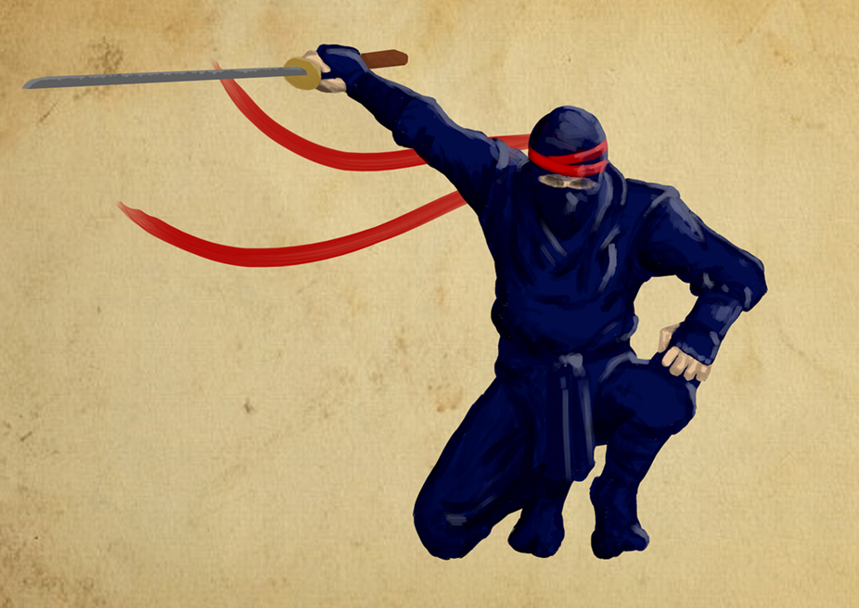
Ontwerp / GDD

Slide 4
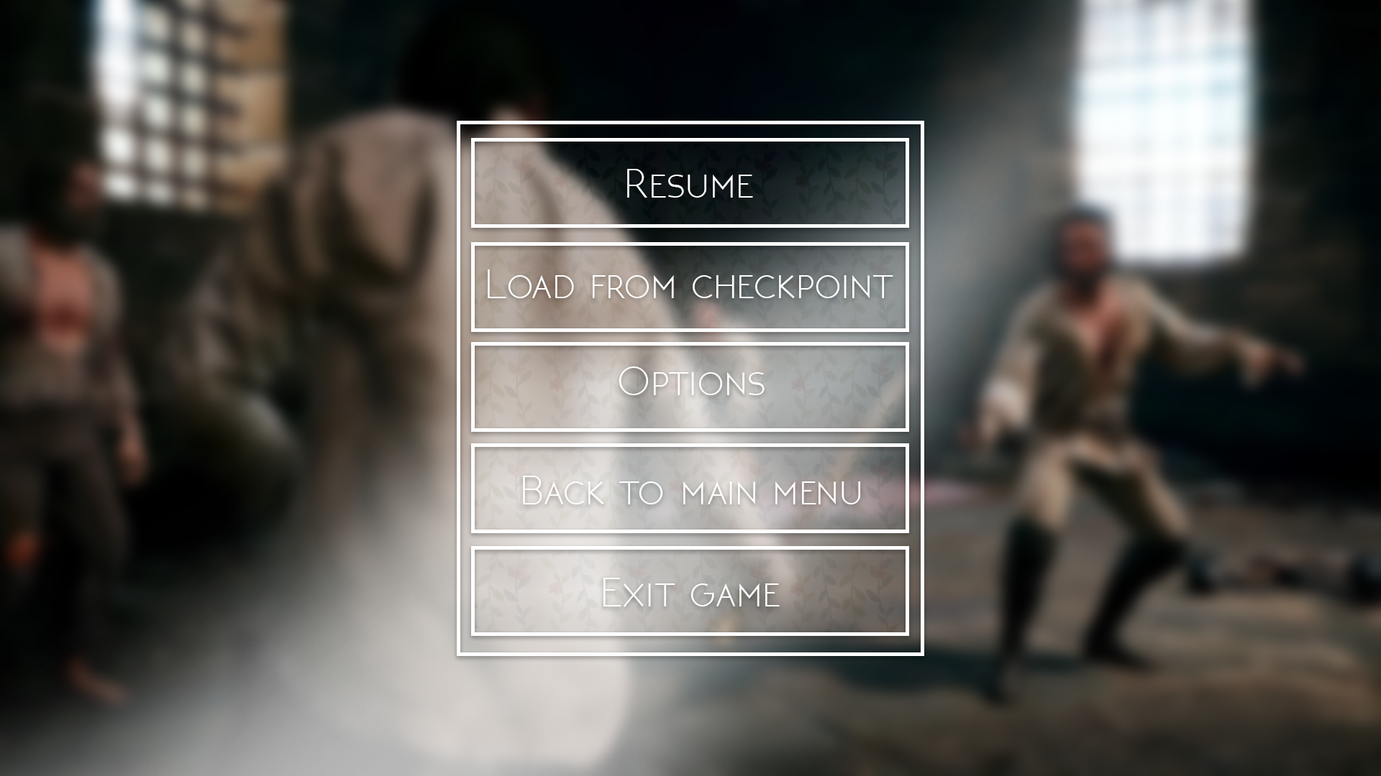
Ontwerp / GDD Grafisch Ontwerp
-Character
-Enemies
-Pickups
-GUI

Slide 5
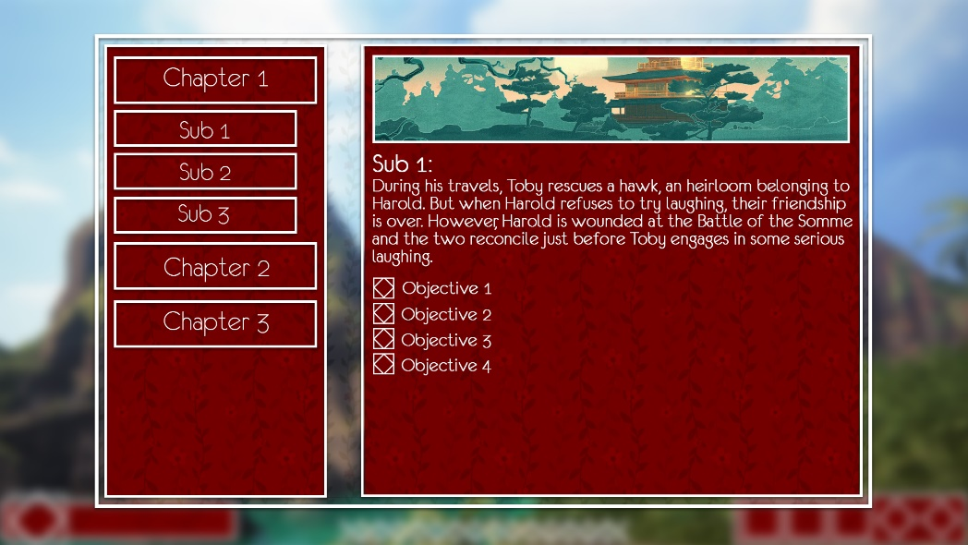
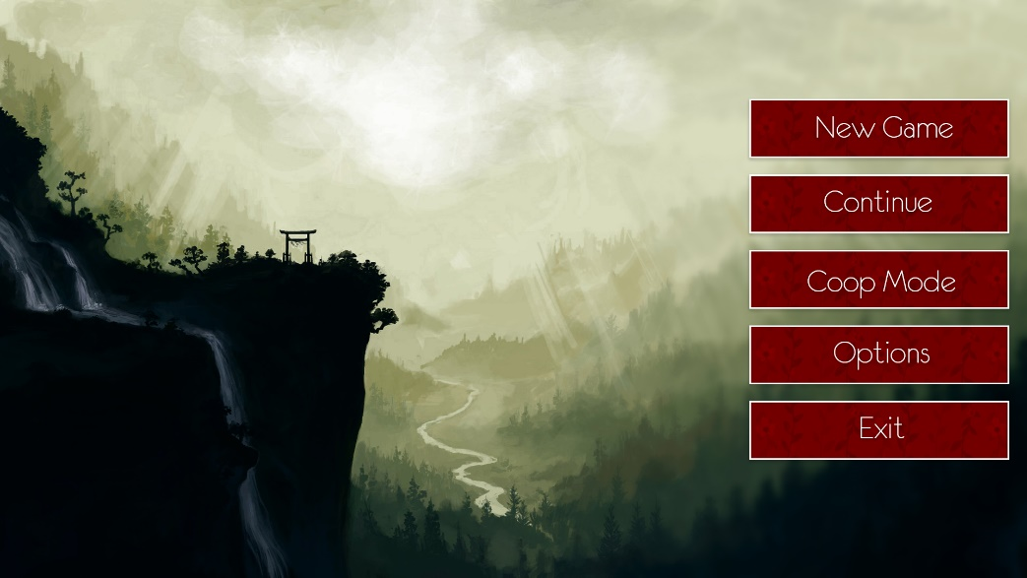
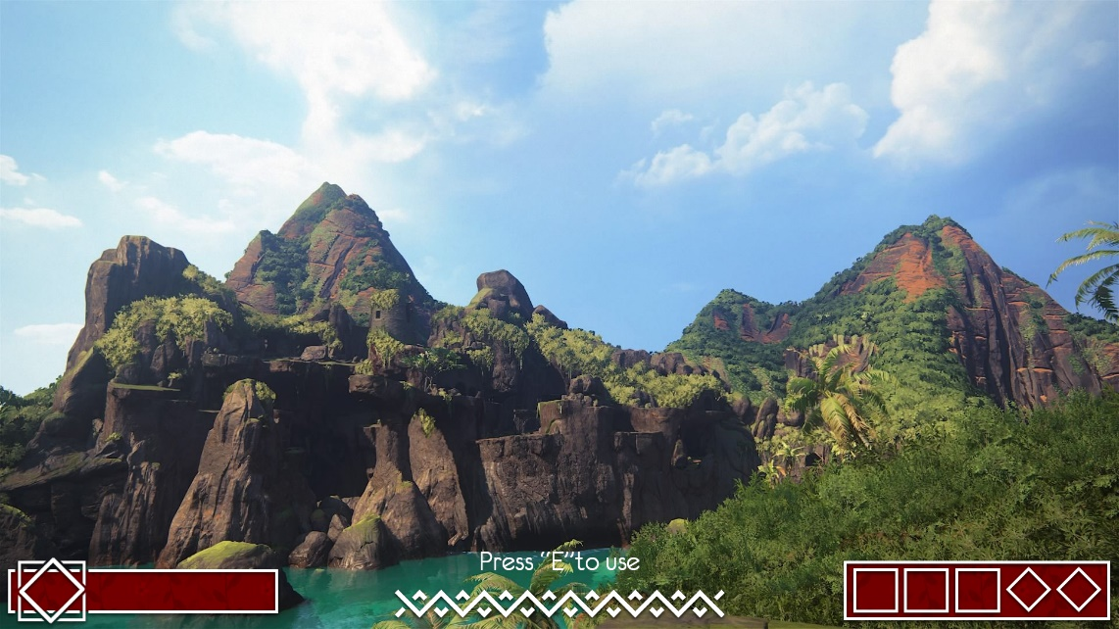
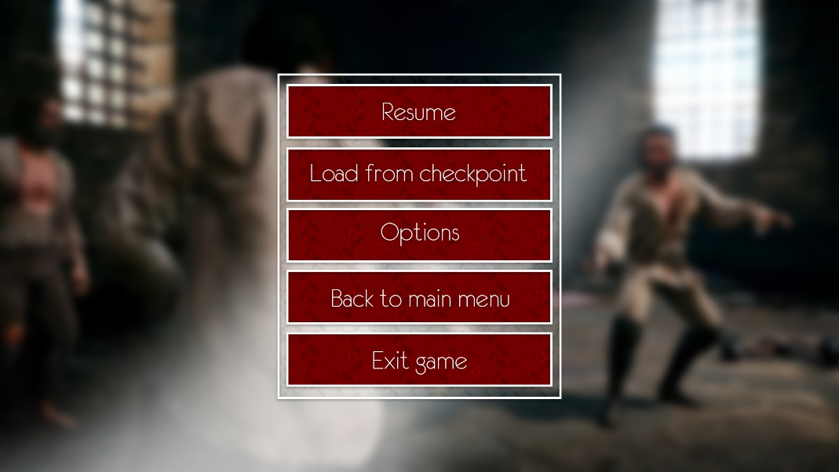
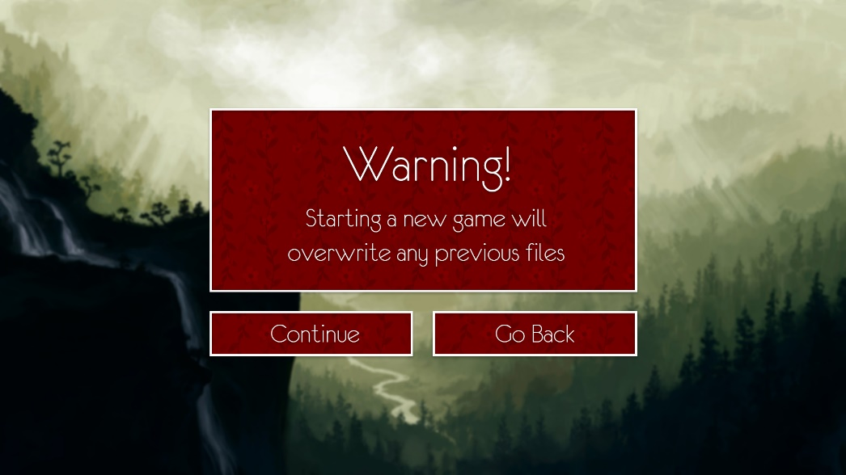
Ontwerp / GDD GUI

Slide 6
Ontwerp / GDD: Functioneel Ontwerp
-Camera
-Controls
-Enemies
-Player abilities
-Level Design
-Pickups
-GUI

Slide 7
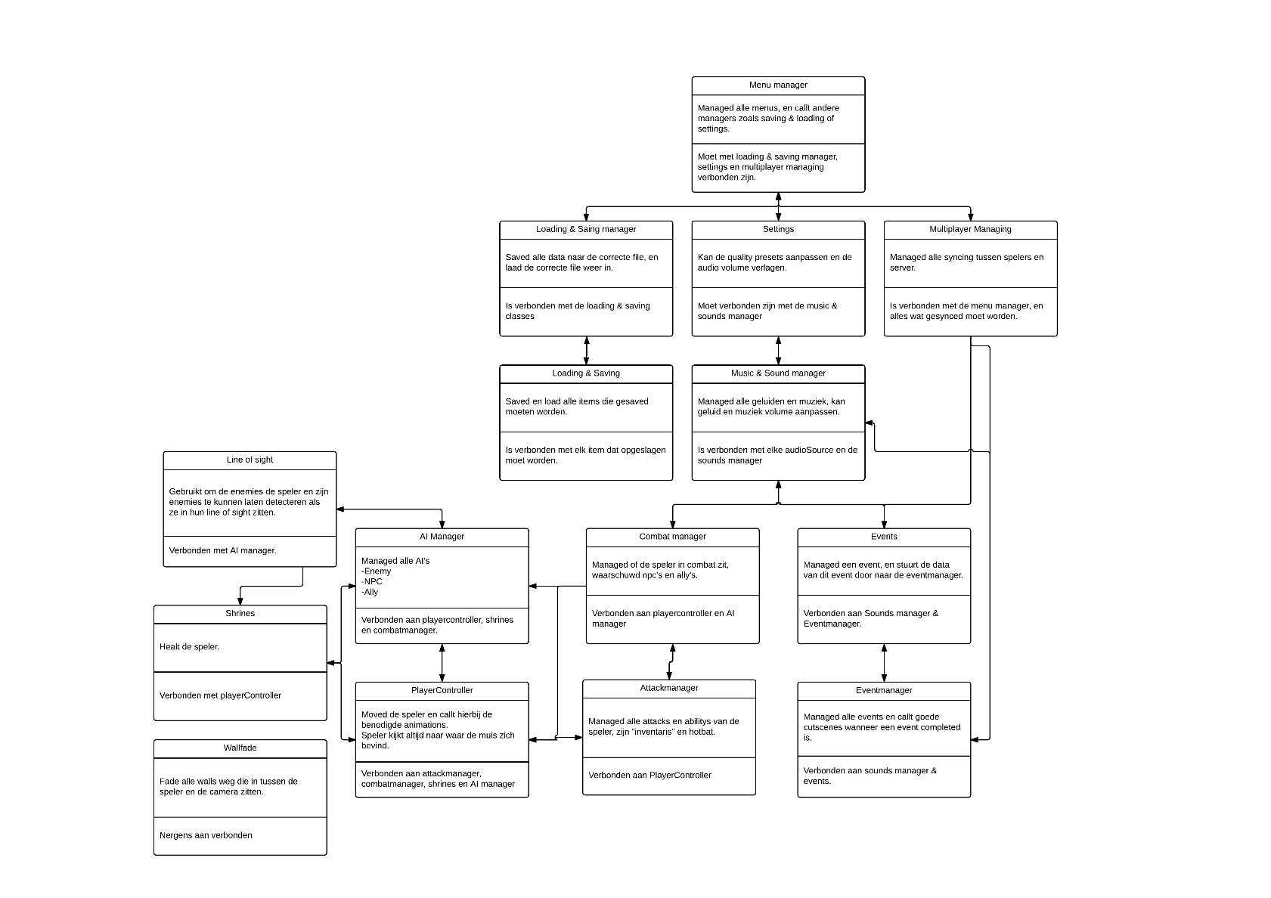
Ontwerp / GDD: Technisch Ontwerp
-Enemies (AI)
-Camera
-Player abilities
-Pickups
-GUI

Slide 8

Realisatie

Slide 9
Realisatie: Grafische staat
Models
- Playermodel
- Enemies
- Weapons
Levels
- Modular Pieces
- Greyboxing
- Buildings
Particle Effects
- Attacks
- Abilities

Slide 10
Realisatie: Technische staat
AI
- Orthogonal Unit Differentiation
- State machines
Stealth
- Field of view
Player
- Twin stick shooter inspired
- Feet states
Saving & Loading
- XML based loading & saving

Slide 11
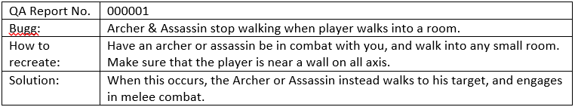
Realisatie: QA
Very little Buggs
No QA person in team
- Bugg test before implementing

Slide 12
Realisatie: Prototype
- Game footage

Slide 13
Planning

Slide 14
Planning: Deadlines
Progress is slow
- Very little deadlines hit on the art side
- Mediocre progress on programming side, playercontroller not as far as planned.
- Events not started, planned after playercontroller is done.
Talks about input
- Up our game
- Altered level design
- Now devided level 1 & 3 in multiple smaller sections
- Scrapping game time without losing massive parts

Slide 15
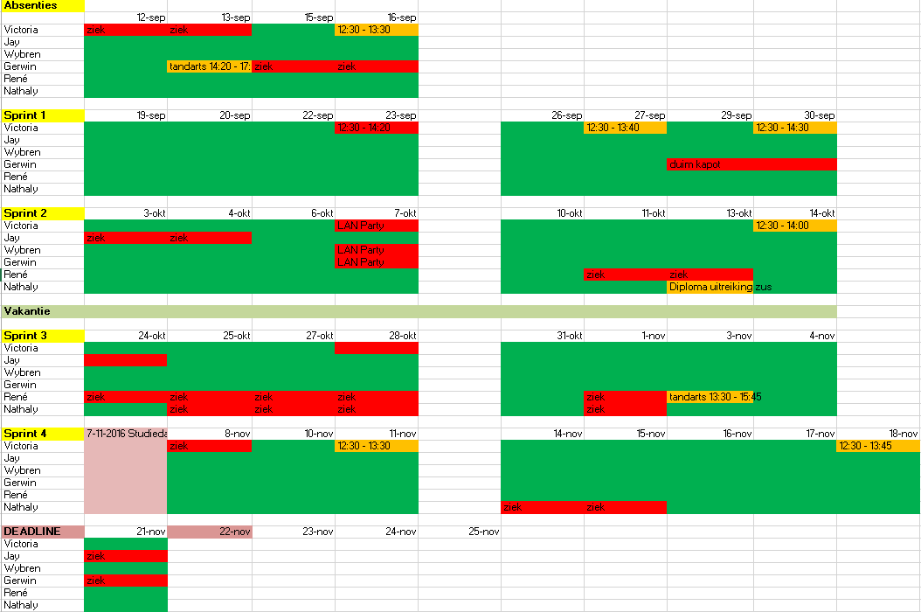
Planning: Uren registratie

Slide 16
Planning: Planning beheer

Slide 17
Planning: Rolverdeling aanhouden
Aanhouden
- Helpen waar nodig
- Rollen worden voornamelijk goed uitgevoerd.

Slide 18
Organisatie

Slide 19
Organisatie Naming convention

Slide 20
Organisatie Repository
Github errors
- Failed to sync
-

Slide 21
Organisatie Sources

Slide 22
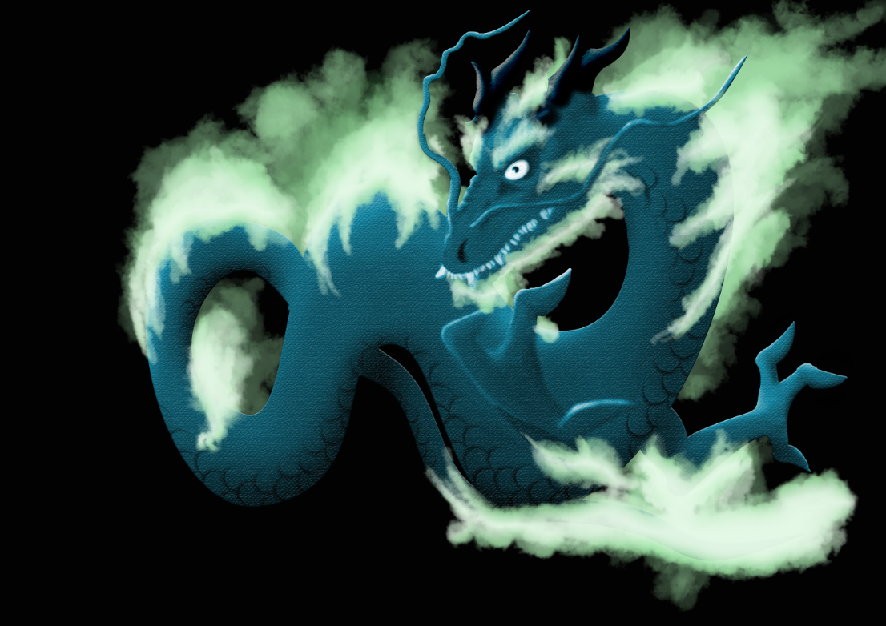
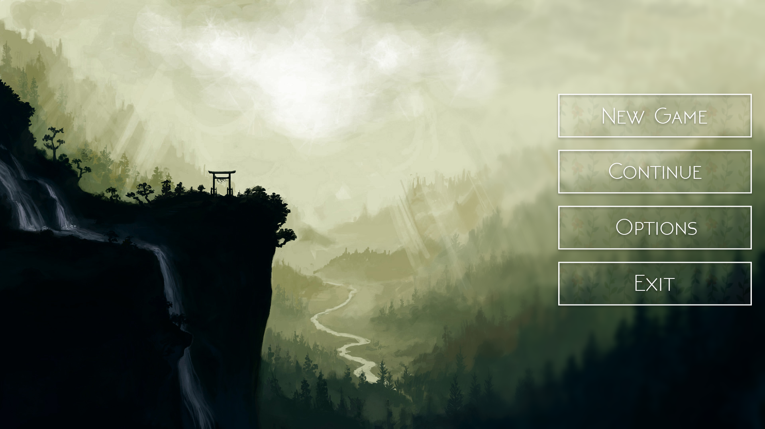
Concept

Slide 23
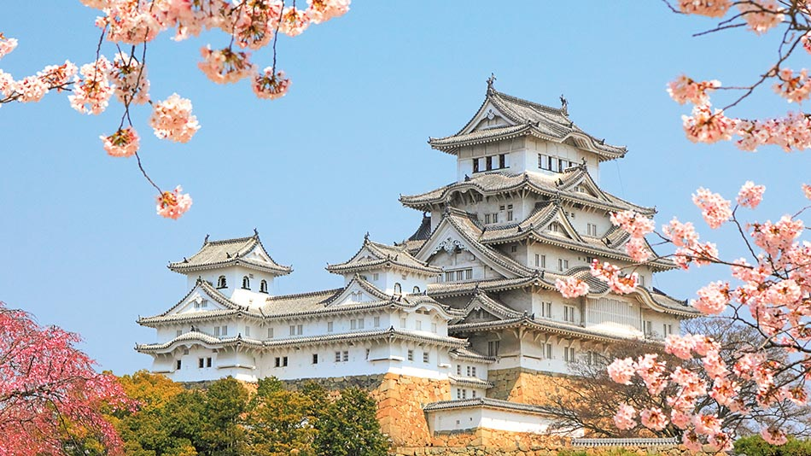

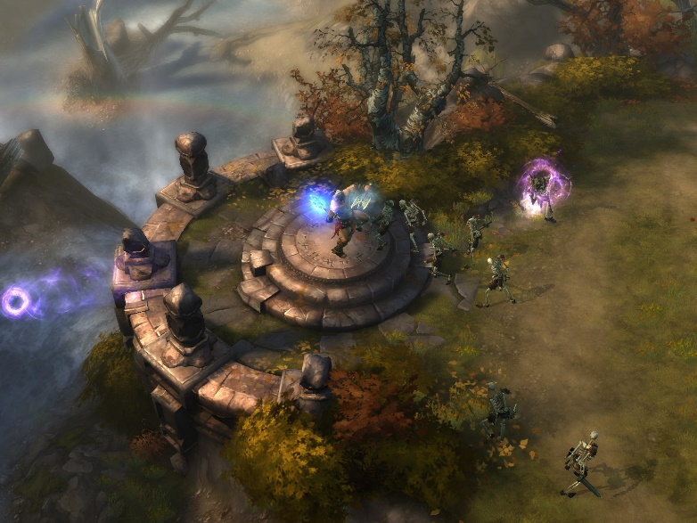
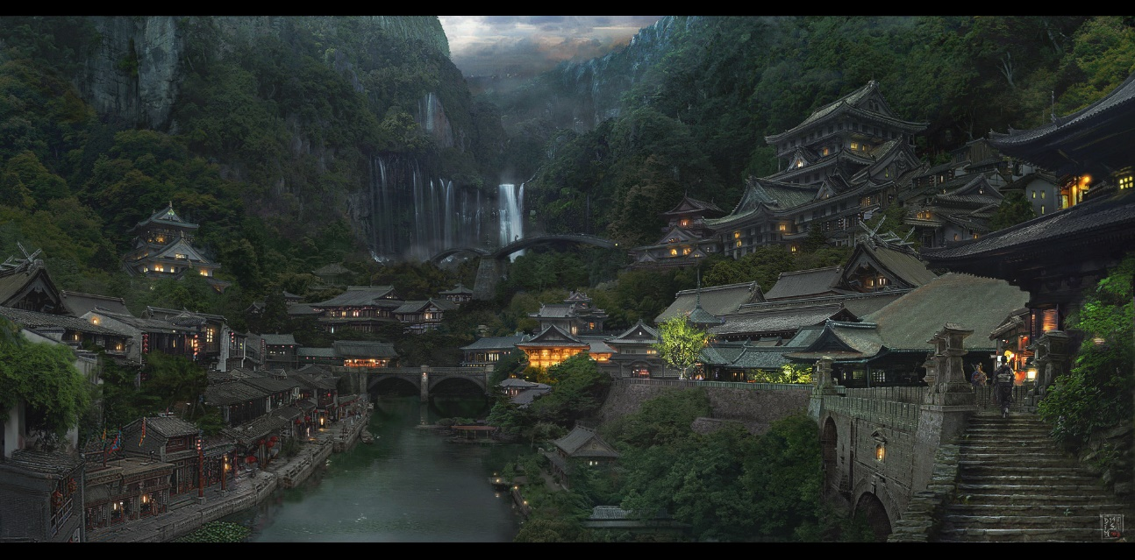
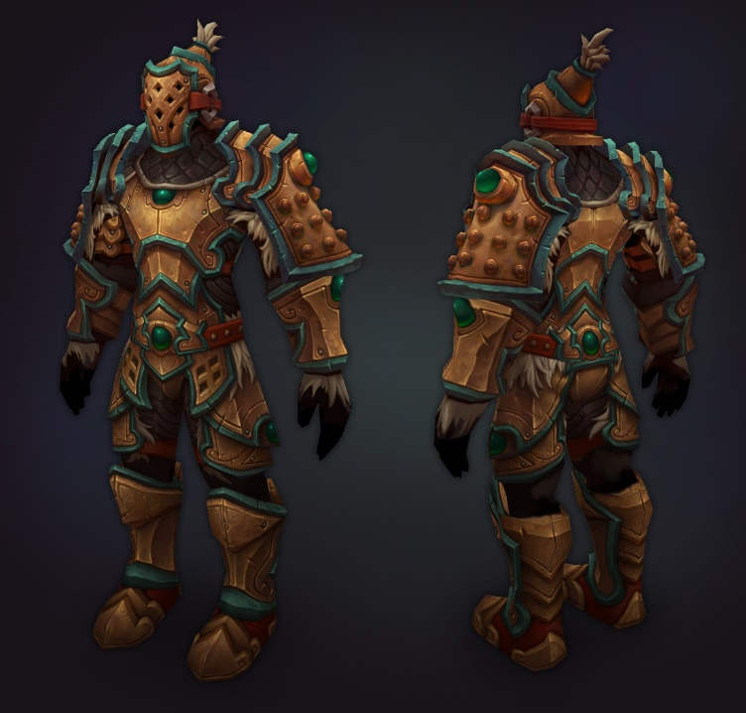
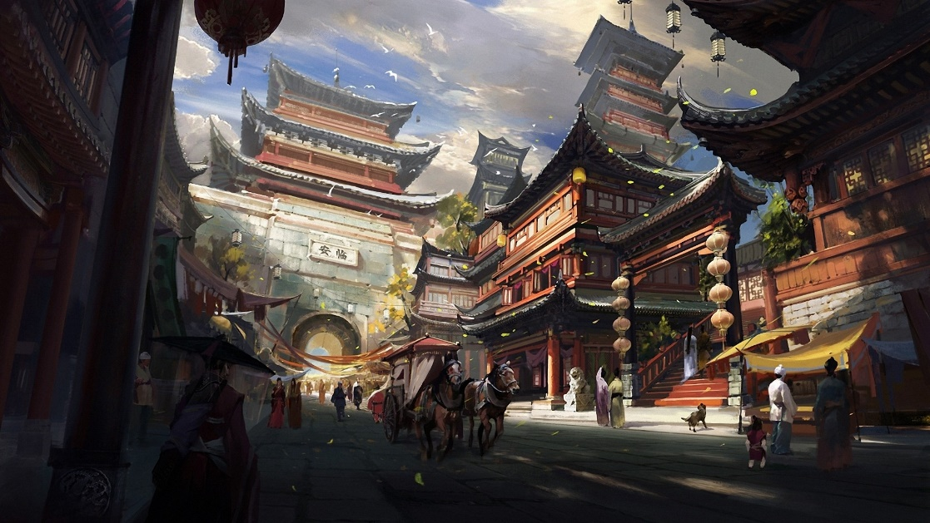
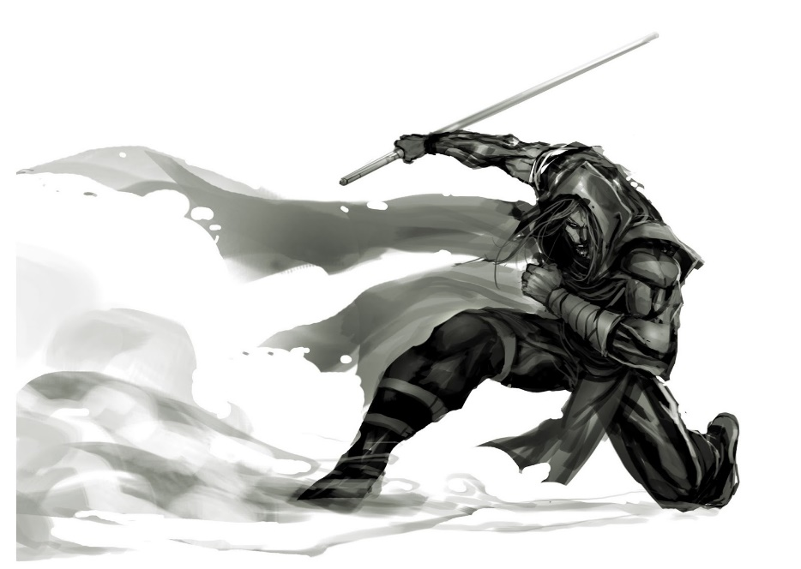

Concept Style Guide

Slide 24
Concept Busines value(?)
- Target Audience

Slide 25
Einde Nog vragen?

